Slide 1

CONCEPTS OF PROGRAMMING LANGUAGES
12th Edition
Chapter 1
Preliminaries

Slide 2
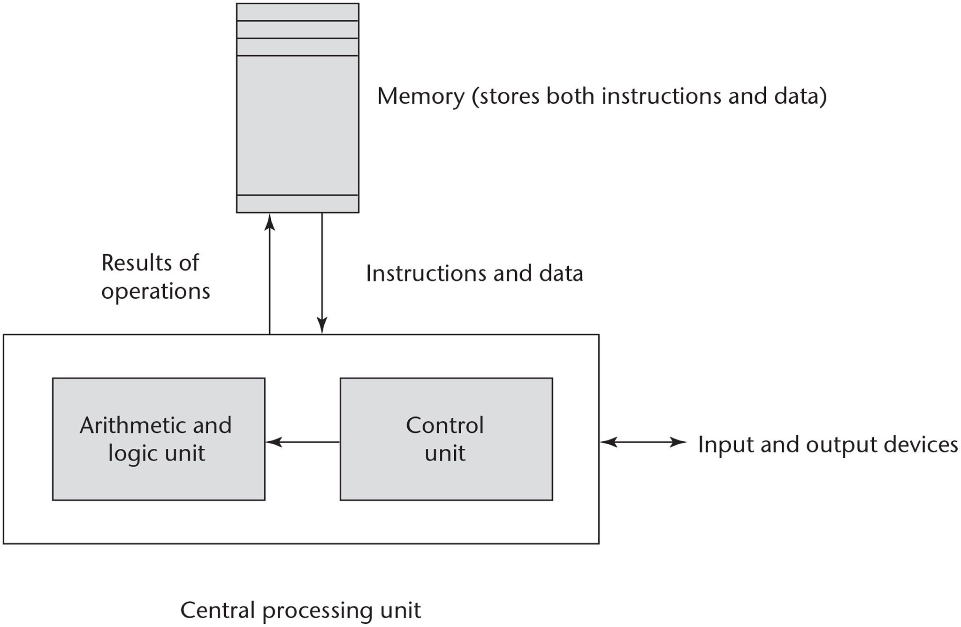
Figure 1-1 The von Neumann computer architecture

Slide 3
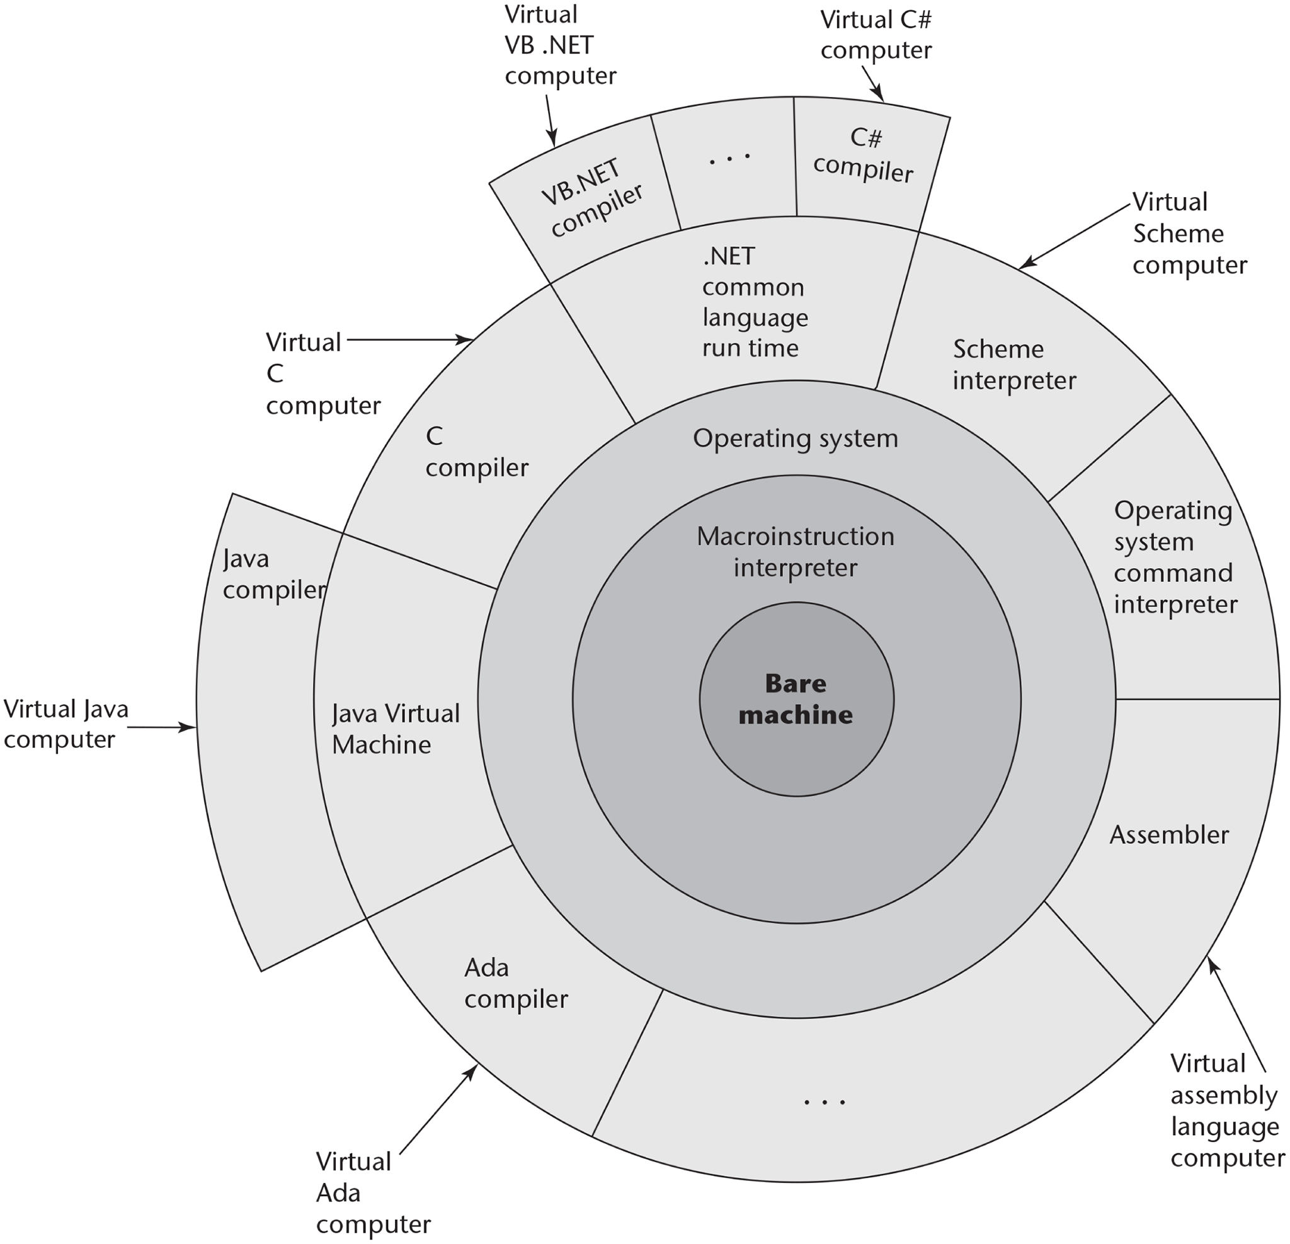
Figure 1-2 Layered interface of virtual computers, provided by a typical computer system

Slide 4
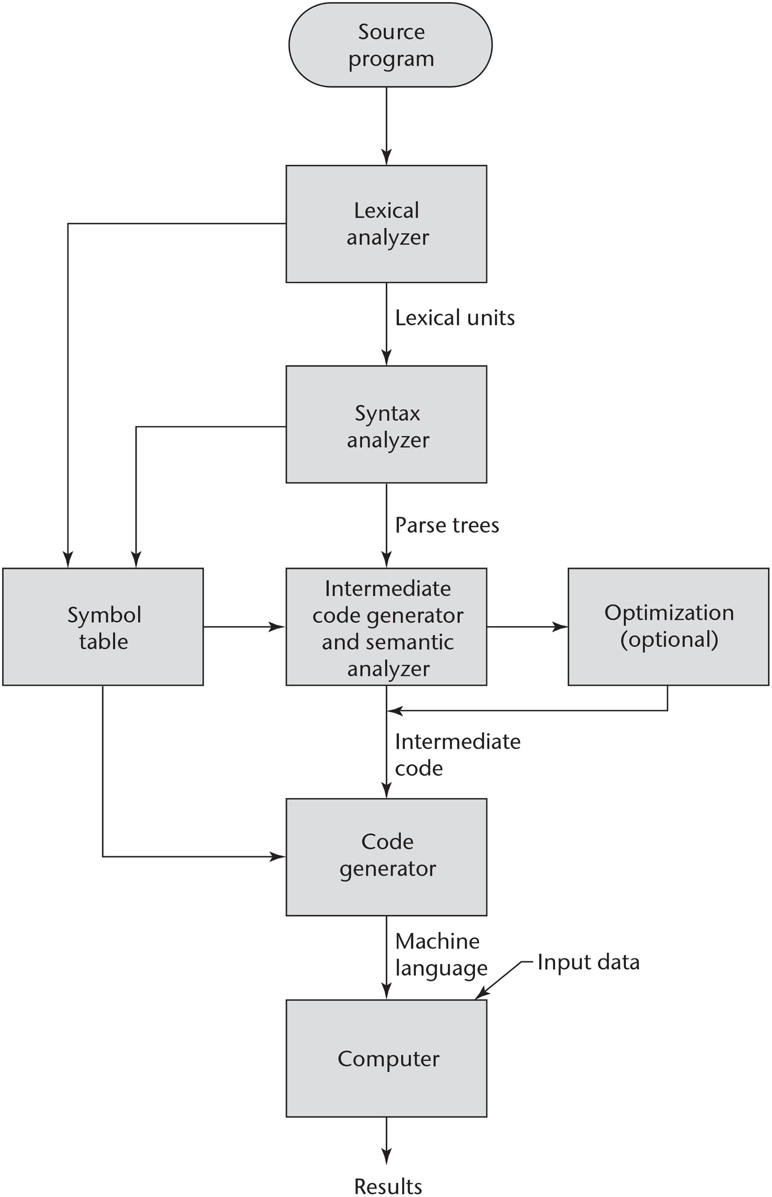
Figure 1-3 The compilation process

Slide 5
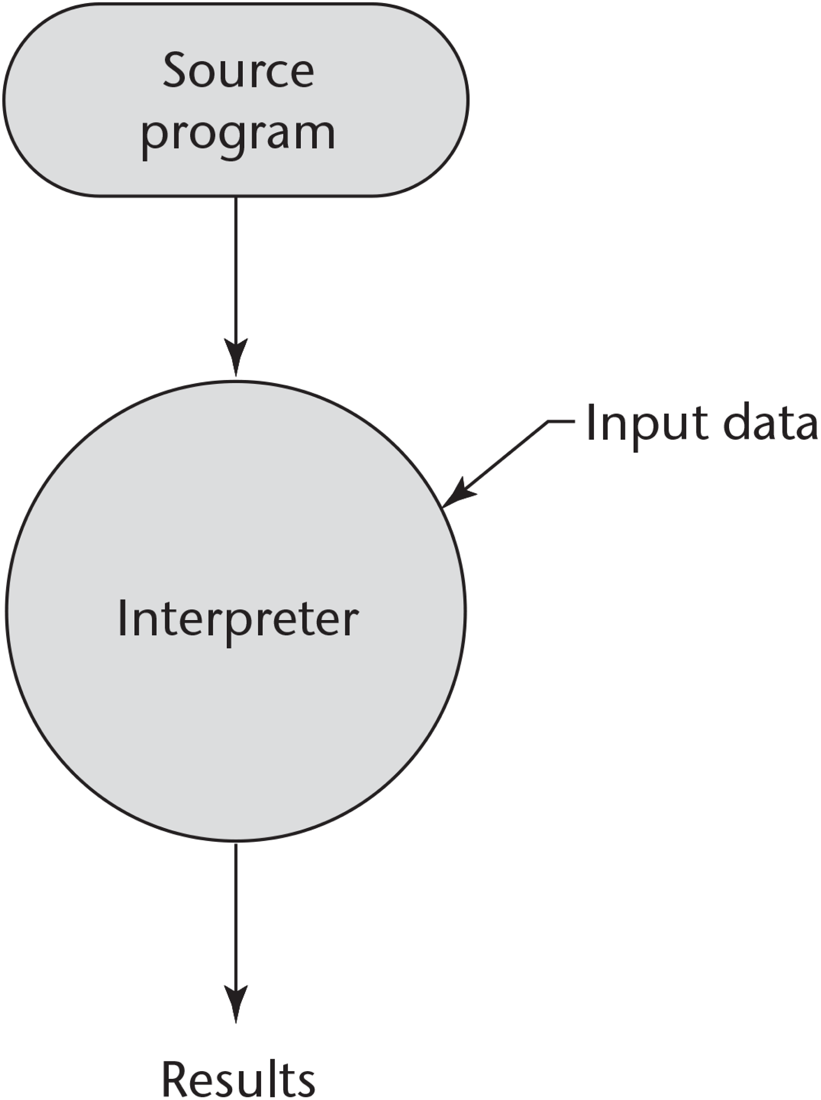
Figure 1-4 Pure interpretation

Slide 6
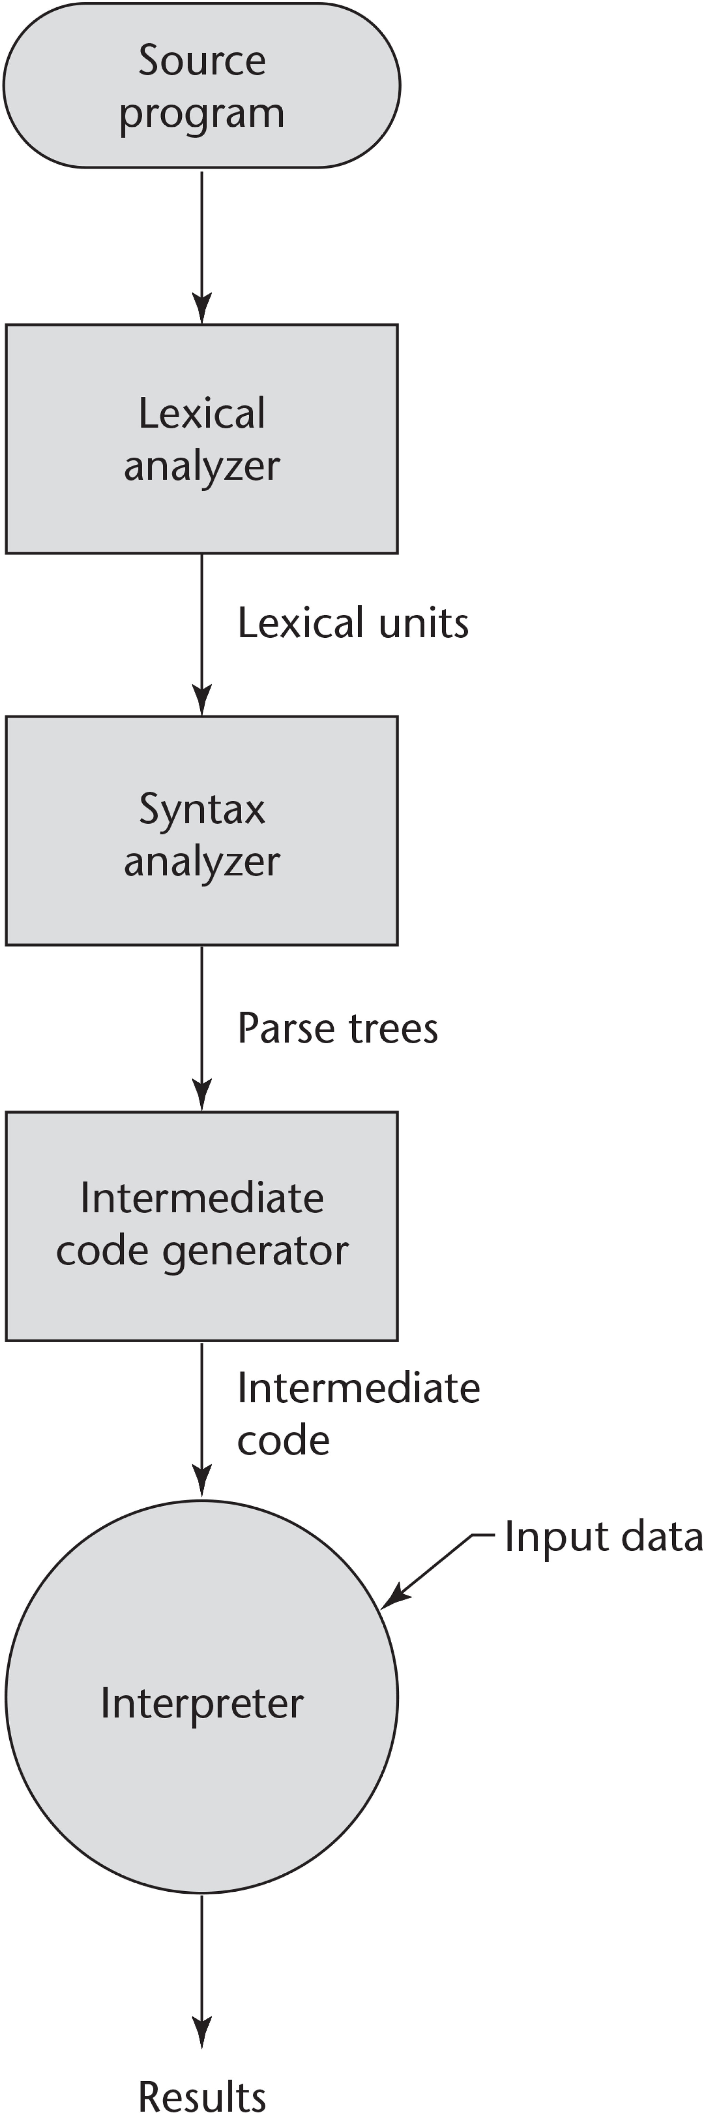
Figure 1-5 Hybrid implementation system

